Slide 1
Energy Efficiency for Residential Buildings
Tauseef Ashraf

Slide 2
Agenda
Business Question
Rationale
Delivery
Data Pipeline
Summary
Conclusion

Slide 3
Business Question
Predict space conditioning requirements for Energy Efficient Residential Building

Slide 4
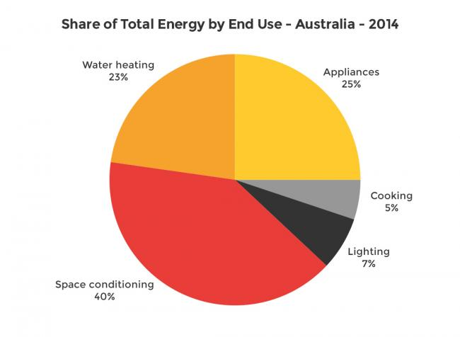
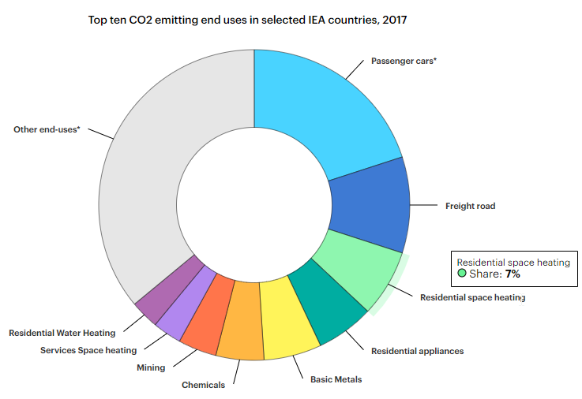
Rationale – Environment

Slide 5
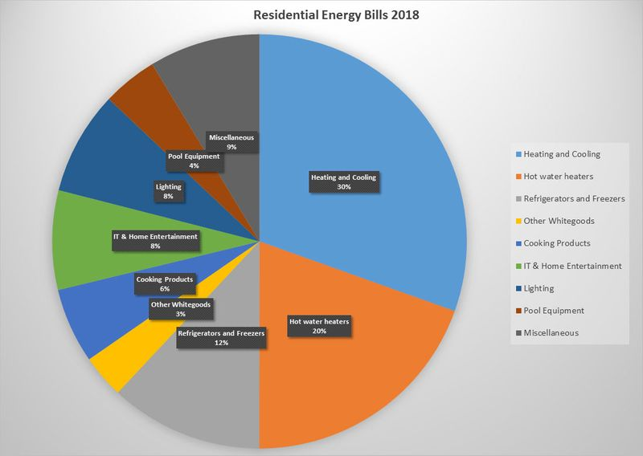
Rationale – Commercial
Aussies spend a collective
$2 billion
on aircon over the summer period

Slide 6
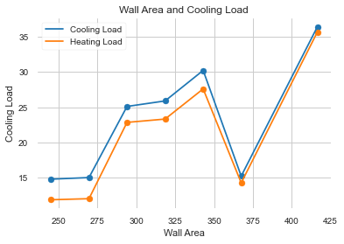
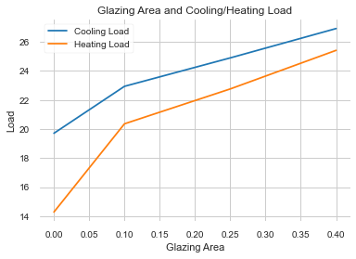
Deliver

Slide 7
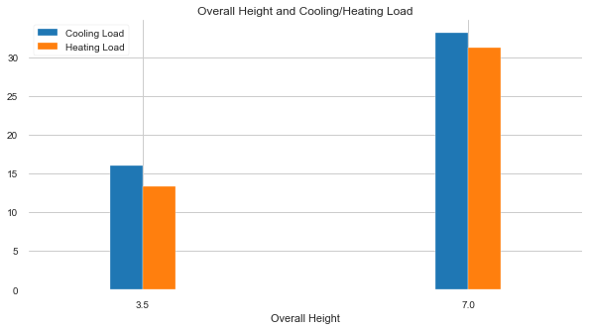
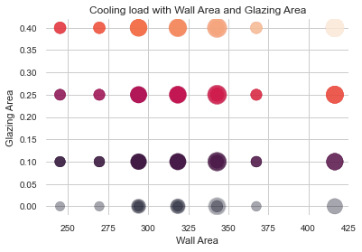
Delivery

Slide 8
Data pipeline
Business Question
Data Capture
Data Analysis
Modelling
Feature Selection
Energy efficient design

Slide 9
Summary
Dataset | Approach | Outcome
No of observation: 768 Features: 10 Target Variables: Cooling Load Heating Load | Features selection based on their impact on cooling and heating load Apply Modelling on selected features: Glazing Area Overall Height Roof Area Wall Area Relative Compactness | Energy efficient building designs Cooling and Heating Load values to determine Cooling and Heating equipment specifications

Slide 10
Conclusion
Surface conditioning requirements can be predicted with 88% accuracy
Following features impact surface conditioning requirements the most:
Surface Glazing Area
Overall Height
Roof Area
Wall Area
Relative Compactness

Slide 11
THANK YOU

